Slide 1
Company Bankruptcy Prediction
Xinrui Shen (Piper)
1306233
Notes:
Hello, everyone. My name is Xinrui Shen and I'm excited to present my Bankruptcy Prediction Project. This work focuses on using predictive analytics to spot early signs of corporate failure, turning raw financial data into actionable warnings for businesses.

Slide 2
Problem Statement
Background:
Rising economic volatility → firms face debt, profit decline, macro shocks
Traditional analysis: subjective, lagging, poor in early risk detection
Bankruptcy affects creditors, investors, employees, market stability
Key question: Can financial statement data and predictive analytics help us forecast the probability of bankruptcy years in advance, so stakeholders can take action before failure happens?
Notes:
In today’s uncertain economy, companies face serious risks from high debt, falling profits, and shocks like rising interest rates or global supply chain disruptions.
Traditional financial analysis often reacts too slowly and relies on subjective judgment, so early warning signs are easily missed.
Bankruptcy doesn’t only hurt a company—it affects creditors, investors, employees, and even the overall market.
So my key question is: Can financial statement data and predictive analytics help us forecast the probability of bankruptcy years in advance, so stakeholders can take action before failure happens?

Slide 3
Data Set Information
• From kaggle US Company Bankruptcy Prediction Dataset
• The goal is to develop accurate bankruptcy prediction models for U.S. public companies listed on NYSE and NASDAQ using accounting-based features. The binary classification task predicts whether a company will file for bankruptcy in the following fiscal year (label = 1) or continue normal operations (label = 0), based on financial data from the prior fiscal year.
• The dataset contains 78,682 firm-year observations (8,262 unique companies) from 1999–2018, with no missing or imputed values.
The data from 2013–2018 is selected , giving me 19,270 clean and reliable observations
• 18674 (65.5%) are alive
• 596 (34.5%) are failed
• The dataset contains 18 variables and doesn’t include the variable name
X1 | X2 | X3 | X4 | X5 | X6 | X7 | X8 | X9
Current assets | Cost of goods sold | Depreciation and amortization | EBITDA | Inventory | Net Income | Total Receivables | Market value | Net sales
X10 | X11 | X12 | X13 | X14 | X15 | X16 | X17 | X18
Total assets | Total Long-term debt | EBIT | Gross Profit | Total Current Liabilities | Retained Earnings | Total Revenue | Total Liabilities | Total Operating Expenses
Notes:
For this study, I used U.S. Corporate Bankruptcy Prediction dataset from Kaggle.
It contains over 70,000 firm-year observations between 1999 and 2018, with 21 financial statement variables.
The target variable is simple: bankrupt = 1, non-bankrupt = 0.
For my analysis, I focused on the most recent period, 2013–2018, giving me 19,270 clean and reliable observations
Each record features 18 key financial variables from annual statements, and the table below shows the variable names and corresponding financial data.

Slide 4
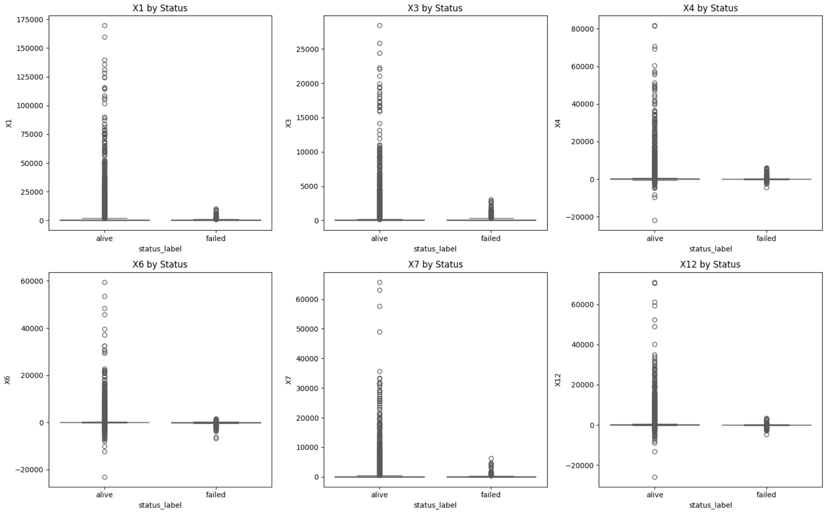
Data Cleaning & Exploratory Data Analysis (EDA)
Bankrupt companies are extreme outliers in almost every ratio
Healthy firms cluster around positive values
Bankrupt firms form a visible “tail” or separate cluster in the negative region
Data Cleaning Basics: Loaded the dataset (19,270 records from 2013-2018). Checked for missing values (none found), duplicates (zero), and inconsistencies (company statuses consistent over years).
EDA:
        Bankrupt companies are extreme outliers in almost every ratio
        Healthy firms cluster around positive values
        Bankrupt firms form a visible “tail” or separate cluster in the negative region
Notes:
For data cleaning part, I checked for missing values, duplicates, inconsistencies, and abnormal entries. And the dataset was already structured and clean.
In exploratory data analysis, it is obvious that Bankrupt companies tend to cluster in the extreme negative areas of key financial ratios. Box plots shows that the survivors clustered around positive ratios, while failures closed toward the negatives.

Slide 5
Challenge
Severe Class Imbalance
Bankruptcy cases are extremely rare, making them easy for models to miss.
High Accuracy Can Be Misleading
A model predicting "non-bankrupt" every time may score 95% accuracy but still be useless.
Traditional Models Lack Flexibility
Tools like the Altman Z-score rely on fixed formulas that may miss modern economic risks.
Notes:
I faced some major challenges:
First, bankruptcies are extremely rare, creating a serious class imbalance. A simple model could always predict “non-bankrupt” and show high accuracy—but it would be completely useless for detecting risk..
Second, High Accuracy Can Be Misleading. The main focus is recall to identify high-risk companies. Missing even a small number of distressed firms could lead to major financial losses.
Finally, traditional tools like the Altman Z-Score can be useful, but they don’t always capture today’s fast-changing economic conditions.
So the goal was clear: Build a model that catches rare bankruptcy cases with high recall, while staying transparent and explainable for real business use.
The Altman Z-Score is the world’s most famous and battle-tested bankruptcy prediction model. It combines five key financial ratios into a single score — the lower the score, the higher the probability of bankruptcy within the next 1–2 years.

Slide 6
Methodology Overview
Data Preparation & Preprocessing
  Key financial ratios
  StandardScaler
  Stratified sampling (80/20)
Models Tested
  Logistic Regression (high accuracy, failed for recall)
  Random Forest (average precision is low)
  Decision Tree
Evaluation Focus
Prioritized recall, ensuring the model captures as many high-risk companies as possible.
Notes:
To overcome these challenges, my methodology follows a structured process.
For the Preprocessing part, I constructed key financial ratios from the raw data to capture solvency, profitability, efficiency, and growth.
I standardized all features using the StandardScaler to make the dataset more stable and ensures that features measured on different scales do not dominate the model’s behavior.
Then, the dataset was divided into training and testing sets using stratified sampling. I chose 80% for training and 20% for testing.
After that, I tested three models:
Logistic Regression: It achieved a high accuracy, But the recall for the failed class was 0%
Random Forest: The ROC-AUC demonstrates strong global discrimination, but the average precision was low.
Decision Tree is more meaningful and performed best. It contains high accuracy and understandable financial probability.
StandardScaler transforms each feature to have zero mean and unit variance (z-score), making features comparable regardless of their original scale.
Receiver Operating Characteristic Curve & Area Under the Curve: How good is your model at sorting positives above negatives

Slide 7
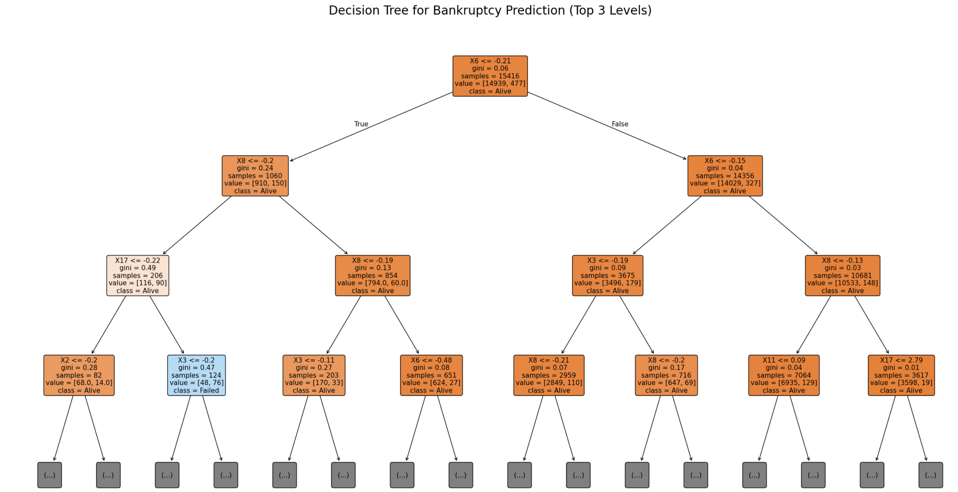
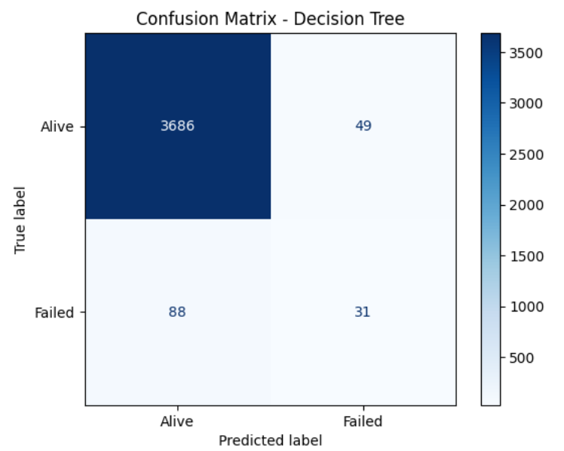
Methodology-Decision Tree
Best Balanced Performance for Imbalanced Data
Balanced recall and accuracy even with imbalanced data.
Strong Interpretability
Reflect classical financial logic—first evaluate profits, then capital structure, then debt-paying ability, and finally liquidity.
Clear Risk Pathways for Decision-Makers
Reveal the financial deterioration path of distressed companies.
Notes:
It has best balanced performance for imbalances data. It captured more than one-quarter of all bankrupt companies, improving minority-class recall while maintaining high accuracy.
The top-level splits immediately show how financial ratios contribute to bankruptcy risk and reflect classical financial logic—first evaluate profits, then capital structure, then debt-paying ability, and finally liquidity.
Here is a visual picture of the module.
It reveals the financial deterioration path of distressed companies.
For example: Managers can see: which ratios fail first or how indicators interact,

Slide 8
Business Analysis
Liquidity & Efficiency:
  Early signs of trouble appear in short-term liquidity and asset turnover. When firms struggle to meet short-term obligations or use assets less effectively, risks rise quickly.
Leverage & Cash Flow:
  High debt combined with weak profitability accelerates financial distress. This creates a cycle where companies cannot recover from external shocks.
Size Doesn’t Protect You:
  Even large, established firms can collapse if core ratios deteriorate.
  Past success does not guarantee future stability.
Notes:
From the model, there ate three main insights:
First, Liquidity and Efficiency.
Early warning signs often appear when a company struggles with short-term liquidity or uses its assets less effectively. These declines usually indicate that financial pressure is starting to build.
Second, Leverage and Cash Flow.
When a firm carries high debt but generates weak profitability, financial stress increases quickly. Limited cash flow makes it harder for the company to stabilize and respond to challenges.
Finally, Size is not a guarantee of safety.
Even large and established companies can fail if their core financial ratios weaken. Past performance cannot replace continuous financial health.

Slide 9
Business Impact
Banks & Lenders: Reduce non-performing loans through earlier risk detection.
Investors: Avoid hidden “financial traps” and strengthen portfolio resilience.
Regulators: Identify sector-level risks before they spread.
Companies: Take corrective actions long before bankruptcy becomes unavoidable.
Notes:
For banks and lenders, these insights support earlier and smarter credit decisions. They can reduce bad loans and keep the financial system more stable.
For investors, the model helps them avoid hidden “financial traps” and choose companies with healthier fundamentals, making their portfolios more resilient.
For regulators, it offers a way to monitor risk across entire industries, which helps prevent larger problems, such as supply chain disruptions or rising unemployment.
And for companies themselves, early warning signals give management time to take corrective actions—such as adjusting operations or restructuring debt—to protect long-term stability.

Slide 10
Recommendations
Early-Warning Dashboard
Real-time monitoring of key ratios with automated alerts. Helps managers identify problems immediately rather than waiting for annual reports.
Financial Red-Line Policy
Set minimum liquidity buffers, leverage limits, and cash-flow thresholds. Companies should intervene early instead of hoping conditions improve.
Adopt the Decision Tree for Risk Management
Simple, transparent, and regulator-friendly. Makes it suitable as a core risk assessment tool for banks, firms, and auditors.
Notes:
Finally, Here are some actionable recommendations:
First, an Early-Warning Dashboard.
Companies should monitor key financial ratios in real time with automated alerts. This helps managers spot problems immediately instead of waiting for yearly financial reports.
Second, a Financial Red-Line Policy.
Firms should set minimum liquidity levels, leverage limits, and cash-flow thresholds. When these thresholds are crossed, they should act early rather than hoping conditions improve.
Finally, adopting the Decision Tree for risk management.
The model is simple, transparent, and easy to explain. Because of this, it works well as a core risk-assessment tool for banks, companies, and auditors.

Slide 11
THANKS!

